Slide 1


SMART INDIA HACKATHON 2024
ALUMNI PORTAL
Problem Statement ID –SIH1633
Problem Statement Title-ALUMNI PORTAL
Theme-Smart Education
PS Category- Software
Team ID-
Team Name-TECH_GIANTS

Slide 2
TEAM-INTRO
SUDHANSHU MALL (TEAM-LEADER)
ALOK YADAV
UDAY SINGH PARIHAR
VISHAKHA GUPTA
SUJAL WAINGANKAR
VISHAL VISWAKARMA

Slide 3
ALUMNI PORTAL
TECH_GIANTS
Proposed Solution
We have created a website for maintaining the details about the alumuni ,keeping them updated about the events happening in alma-mater.
We will be adding a “job-profile” and “location” filter helping students of college to find their alumuni basis of location ,job-profile.
A dedicated slot for donation.
A chat-bot will also be available for the convinent of the visitors.
Blockchain technology will be used for the prevention of suspicious activities.

Slide 4
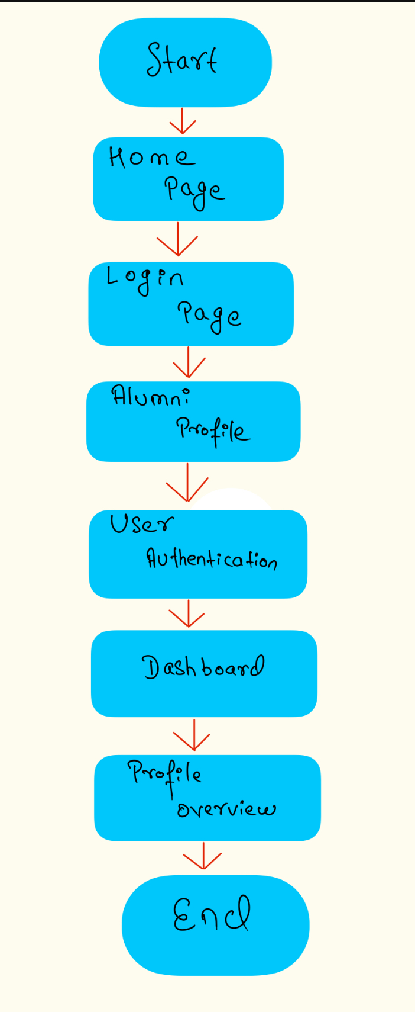
TECHNICAL APPROACH
TECH_GIANTS
We have used language like html,css,javascript and,MERN forbackend,NLP(forchatbot),Blockchain technology like Hyperledger Fabric,Corda.

Slide 5
FEASIBILITY AND VIABILITY
TECH_GIANTS
Technological Feasibility: The platform leverages existing technologies like AI, chatbots, blockchain, and databases, which are readily available and mature for implementation.
Economic and Social Impact: This platform will enhance student career outcomes by providing mentorship, networking, and job placement opportunities. The alumni engagement will strengthen institutional ties, encouraging future donations and support, making the platform both socially and financially viable

Slide 6
IMPACT AND BENEFITS
TECH_GIANTS
This portal will help students of the respective college/university to remain updated about what’s happening in the alma mater and also will help the current students in job hunting.

Slide 7

TECH_GIANTS

